Slide 1
Fostering Guidance and Updates December 2024

Slide 2
Session Objectives: Safe Internet Use and the impact of social media. Free online safety virtual workshop | NSPCC Discussion time

Slide 3
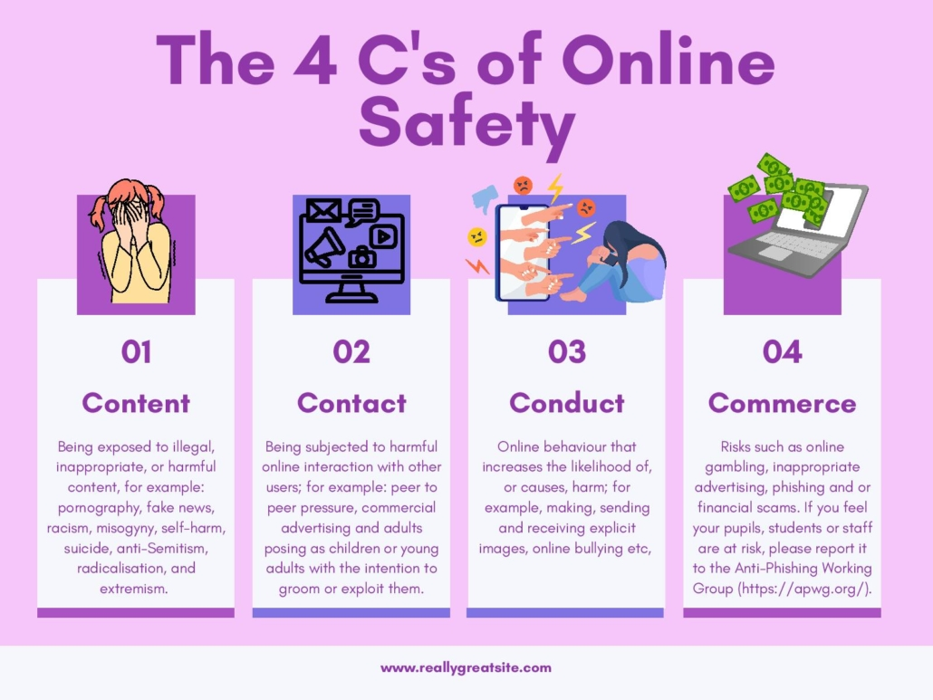
The internet, for all its usefulness and opportunities, does unfortunately feature threats and challenges. These might manifest as online abuse, bullying, threats, impersonation, grooming, harassment or exposure to offensive and/or violent content. These threats are sometimes referred to as the 4 C’s
All of these are harms we have a duty to protect young people from – and we shouldn’t underestimate their seriousness. If young people are exposed to – or perpetrate – these behaviours, they can be life-altering.

Slide 4
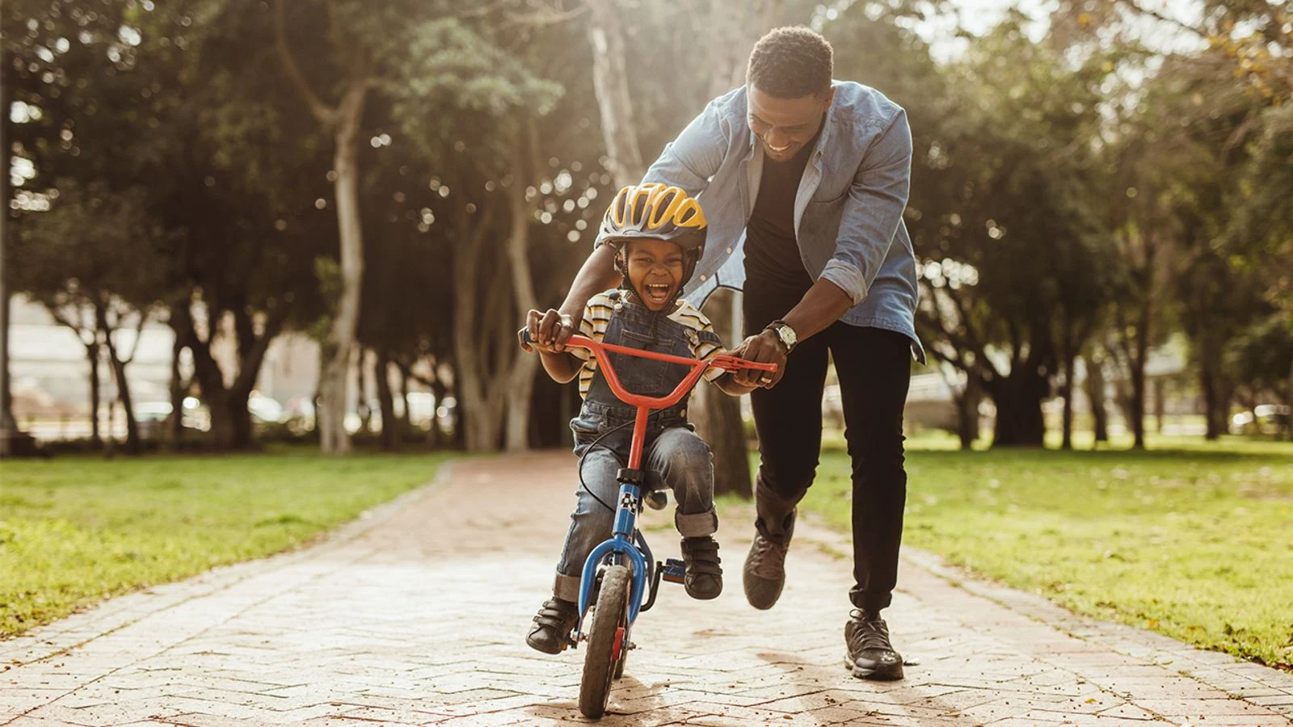
xxxx
Being aware of and practicing online safety is the only way to mitigate these risks. They will always be present but teaching young people to be aware of risks and how to manage harmful situations/content will ensure they are best-placed to benefit from their time online.

Slide 5
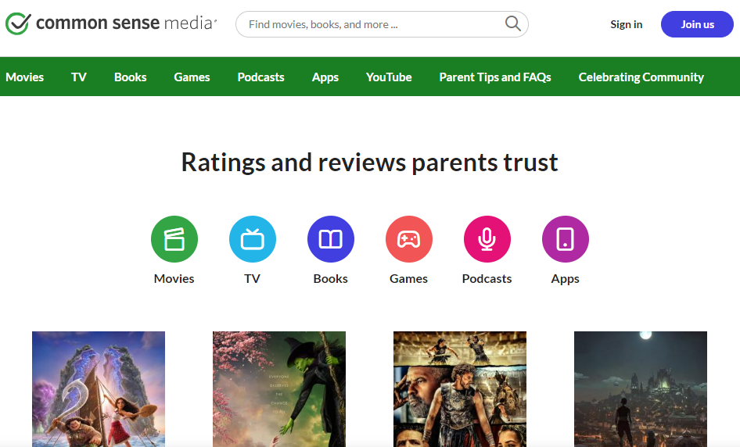
5
You don’t need to be an expert on the internet!
If you want to know what your child is doing online, the best thing you can do is talk to them about it.
Ask your child to show you their favourite things to do online and take an interest in what they do – just like you would their day at school.

Slide 6
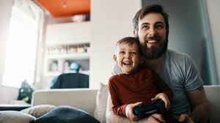
6
Talk about the good stuff, not just the bad.
Sometimes, as adults, we’re guilty of only talking about online activity when we’re annoyed about it or when something has already happened.
It’s helpful to find time to just be curious, interested, and to praise children for their creativity online and remind ourselves how amazing technology can be. To help with this, why not try playing their favourite game with them?
By having balanced discussions about our children’s online activities, and reinforcing our role as someone they can talk to, they’re more likely to come to us when they’re worried or concerned.

Slide 7
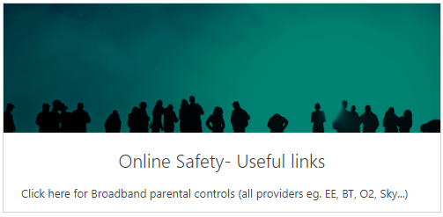
7
Parental controls advice
Practical guides for social media platforms/apps e.g. TikTok, Snapchat, Netflix etc.
Expert review sites; advice, ratings, child’s view etc.
Reporting concerns/harmful content

Slide 8
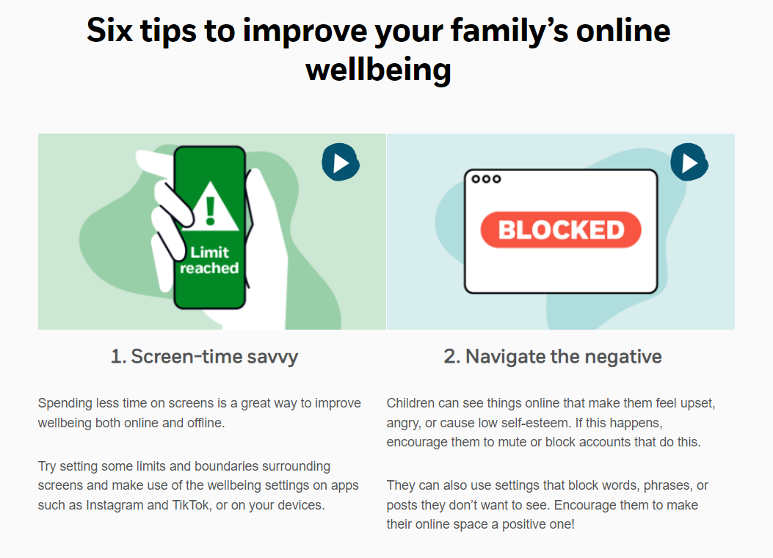
8

Slide 9
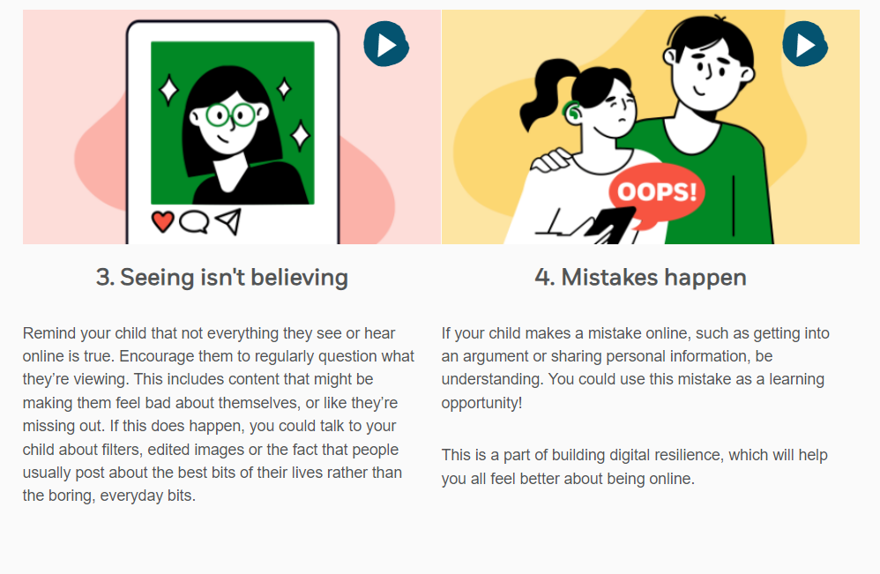
9

Slide 10
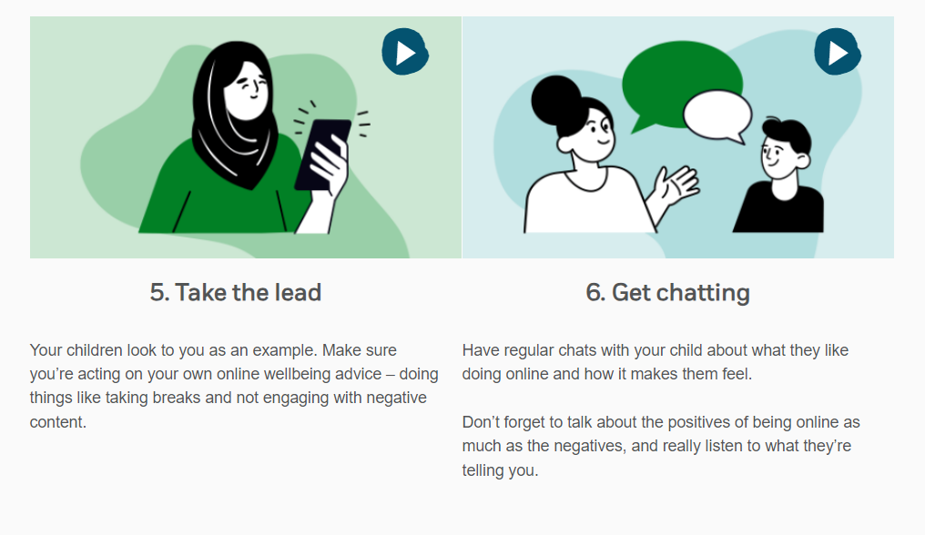
10

Slide 11
These sites and apps are specifically designed to help children with their online wellbeing:
BBC Own it which gives advice as they chat to their friends online.
Headspace for Kids is an app to teach children the basics of mindfulness in a fun way. It’s aimed at 3-12 year olds, with different content for the different age groups. Free for Headspace subscribers, limited access for non-subscribers.
JoyPoP is an app designed to help users find their inner resilience to deal with the highs and lows in their day to day lives. By rating mood for the day, users are directed to complete different activities to help switch to positive emotions. App costs £6.99.

Slide 12
12
Any questions?
Any suggestions for specific issues you’d like to cover in future sessions?

Slide 13
Learning Advocates
Wychavon & North Bromsgrove - Sam Purser spurser@worcestershire.gov.uk
Wyre Forest - Paula Hemming phemming@worcestershire.gov.uk
Worcester City - Sadie Hollow SHolloway2@worcestershire.gov.uk
Redditch & South Bromsgrove - Mary Williams mwilliams2@worcestershire.gov.uk
Roman Catholic Pyramid - Anne Griffin AGriffin@wworcestershire.gov.uk
Out of County - Fiona Eades FEades@worcestershire.gov.uk
Out of County - Steve Judd sjudd@worcestershire.gov.uk
Post 16 - Jill Peplow JPeplow@worcestershire.gov.uk
Post 16 - Jess Reece JReece@worcestershire.gov.uk
Early Years (2, 3 & 4 year olds) - Becky James BJames@worcestershire.gov.uk
Early Years (Reception age) - Becky James BJames@worcestershire.gov.uk

