Slide 1
Designated Teacher Updates and Guidance Session Autumn 2024

Slide 2
Agenda Tuesday, 10th December 2024
Linking Pupil Voice with targets – Sam Purser, VS Learning Advocate
DT/SENCO Liaison for PEPs – Mary Williams, VS SEND Lead
SEND update- Mary Williams, VS SEND Lead.
PEP Updates and questions – Paula Hemming, VS Learning Advocate.

Slide 3
Pupil Voice & Targets
December 24
The aim of gathering the Pupil voice.
Suggestions on gathering the Pupil Voice.
Actions to take from views received.

Slide 4
The Virtual School really want to hear from children and young people about their personal experiences in their settings. There are no rules around this, it is totally free hand and finding a way that suits the young person so they feel comfortable enough to engage with the process is key: some thoughts around this are:
Invite each and every child/young person along to the PEP meeting, it is their meeting after all. They or you can then share their views, and they can be part of their plan.
If they do not wish to attend, then no formal interview/discussion is required.
You do not have to follow a specific format.
If a setting is not being attended and the young person does not wish to attend their meeting, then their views could be gathered and shared by another professional.

Slide 5
If something is shared that requires further action, the box below should be completed by the DT.
Website for PEP related guidance: www.worcestershire.gov.uk/council-services/schools-education-and-learning/virtual-school/virtual-school-personal-education-plan

Slide 6
DT/SENCO Coordination
December 24

Slide 7
If you have CLA on the SEN register – talk to the SENCo before the PEP meeting.
From the PEP document:
Special Education Needs - EHCP Provision/Support
Does this child/young person have special education needs? Yes or no
If so, please select the correct code of practice stage. SEN support (k), EHCP
If this child/young person has an Education Health and Care Plan (EHCP) or SEND support plan, please identify primary need. Drop down list – select best fit

Slide 8
Has the EHCP or other SEND support plans been uploaded into the child's documents section? Most recent final EHCP, Annual review documents (only once a year), IEP, IPM, pupil passport – whatever you call the document in your setting (termly)
When is the SEND/EHCP support plan due to be reviewed? EHCP AR date, IEP will be reviewed every term – please provide the date.
Previous interventions and support - The information is pre-populated from the previous PEP.
Interventions and support. If this child/young person has an EHCP or SEND support, you must identify the additional provision that is in place (update termly)

Slide 9
Additional information relating to SEND. Details of SEN notional funding spend, costed provision maps to provide evidence for EHCNA requests and funding requests from the VS.

Slide 10
SEN & Additional PP+
From WVS PP+ Policy v2 06-11-2024 – should be used over and above what you would do for any other child in your school.
The PP+ funding can be used to facilitate a wide range of educational support for CLA. It is important that interventions supported by PP+ should be evidence-based and in the best interests of the child.
PP+ cannot be used to support interventions in an EHCP.
Reminder - Worcestershire Virtual School administers the PP+ for Worcestershire CLA to the education provision where they are on roll. A payment will be made at the end of each academic term to the education provider, reflecting the SMART educational targets and funding agreed within the termly PEP process. If funding is required, it must be allocated on the PEP document in order for it to be released to the setting. If no funding is allocated on the PEP document, the setting will not receive funding.

Slide 11
From Education bulletin 191 - 05/12/2024
Latest SEND news and updates
Complete the new online SEND training through Universal SEND Services programme
The Department for Education’s Universal SEND Services programme provides Special Educational Needs and Disabilities (SEND) specific Continuing Professional Development (CPD) for school and further education staff.
The programme’s online CPD units support professionals to make high quality inclusive teaching the reality for every learner. The final unit in the series, ‘Supporting Reading and Comprehension Across the Curriculum’ is now available.

Slide 12
From Education bulletin 191 - 05/12/2024 continued…
Complete the new unit to learn more about:
• how to identify barriers to learners within the core building blocks of reading
• the essential role senior leaders, teachers, reading leads, SENCOs, support staff and others can play in identifying when a child needs support with reading
• how to apply practical strategies to use in the classroom as part of an inclusive approach
Create an account with Whole School SEND to access the unit for free

Slide 13
13

Slide 14
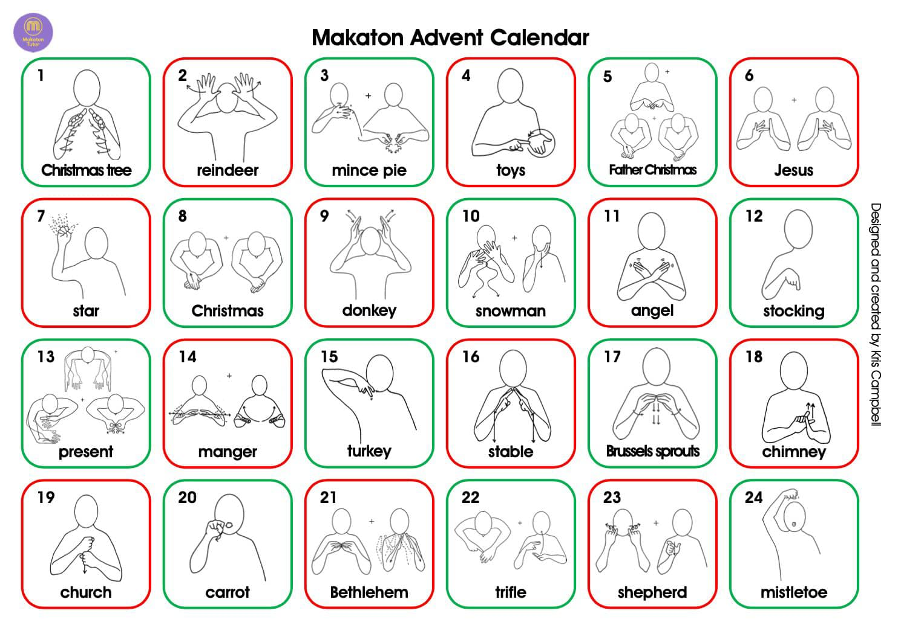
Makaton advent calendar

Slide 15
SEND Updates
Any questions about SEND? Your chance to ask anything that has been niggling with you – no such thing as a silly question!
Anything you would like training on that the Virtual School can support with?

Slide 16
PEP Updates
Data recording
Baselines & Outcomes

Slide 17
Slide 13

