Slide 1
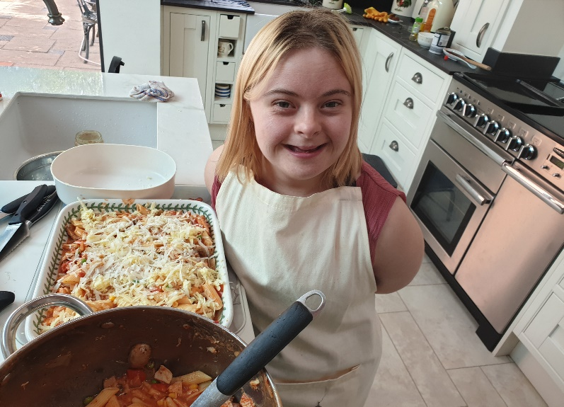
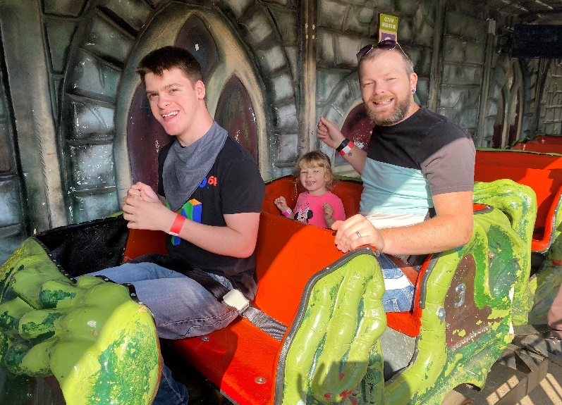
Shared Lives

Slide 2
Introducing Shared Lives
Purpose of Shared Lives:
Worcestershire Shared Lives Scheme provides individuals with care and support needs the opportunity to be part of the family and community of a Shared Lives provider, who in turn will provide friendship and appropriate support and care.
Who is in the team:
Shared Lives Registered Manager
Jenny Parker
Team Leader
Catherine Tyler
Shared Lives Workers
Lin Hall, Natasha Hughes, Kristina Crummy, Nicole Knibbs, Nigel Blackshaw, Julie Wiggins, Kate Frayne, Sally Green
Clerical and Administration
Jenny Eskdale and Sandy Rimell (Job Share)

Slide 3
Introduction to the scheme
Shared Lives is a care and support service for people aged 18 and over. It’s an alternative to Supported Living or Residential Care.
Shared Lives providers can support up to 3 individuals with care and support needs.
Many Shared Lives providers love the flexibility that the role offers including being self- employed and working from home.

Slide 4
Expectations
To be part of the Shared Lives Provider’s family or household.
To be part of the community.
To have opportunities to develop and use new skills.
To have privacy and dignity.
To be treated with consideration and respect.
To have choices and make their own decisions.
To lead the kind of life they want and achieve the things that are important to them.

Slide 5
The process to become a provider
Prospective Providers go through assessment, training and panel approval. They are allocated a Shared Lives worker to support them through this process.
The Portfolio consists of:
Application form
Day in the life, personal profile and community network map
Personal and professional references
DBS check
Occupational Health Check
Permission from a mortgage lender or landlord
Completion of home risk assessments
WCC Care Certificate training or equivalent
Completion of the Shared Lives Scheme induction
A comprehensive assessment document is then completed by a Shared Lives worker and is submitted for examination by an independent WCC panel

Slide 6
Care Quality Commission [CQC] - The Shared Lives scheme is registered with CQC. This means the scheme must evidence our compliance with the regulations and key lines of enquiry - Caring, Responsive, Effective, Safe and Well-Led
Handbook - it is important that providers are given as much information as possible about the Scheme and their role so that they feel comfortable and confident when supporting individuals in their home.
The handbook covers policies, procedures, contractual obligations and also gives information about:
The roles and responsibilities of a Shared Lives Provider
The roles and responsibilities of a Shared Lives worker
Record keeping requirements
Training and development requirements and opportunities
Standards

Slide 7
Shared Lives Plus
Shared Lives Plus is a national advisory body for Shared Lives schemes, providers and workers.
Shared Lives Plus have a UK membership of more than 6,000 Shared Lives providers and 150 Shared Lives schemes
It lobbies the Government about legislation and promoting the service.
Shared Lives Plus is funded by its membership, and several project grants.

Slide 8
The role of the scheme
Allocated worker
Support and monitoring
Ensure compliance
Monday to Friday support – EDT evenings, weekends and Bank Holidays

Slide 9
Referrals
Initial assessment completed by social worker.
Referral to the scheme.
Information collected and passed to potential providers.
If, following receipt of information about each other, both the provider and the individual wish to proceed, the matching process goes ahead [meet and greet visits].
Agreed move in date
Assessment information and care plan passed to provider
28 days after moving in, if the placement is to continue long term, a Placement agreement will be completed to agree the placement.
The decision to accept the referral is the Shared Lives provider’s and the Individual’s. Shared Lives providers need to be aware of this as there is no guarantee of placements.

Slide 10
Contract
A contract is sent out after approval at Panel, which when returned enables the provider to be set up to receive fee payments.
Notice periods - 3 months for providers and 28 days for individuals placements.
Informing the scheme when away from home.
Informing the scheme of any near misses, accidents or incidents.

Slide 11
Fees
Elements of the fee – care and support, rent, household contribution.
1. Care and support – banding system - A profile tool is completed by the involved Social Worker. The profiling tool is used to identify and agree the support that will be required and in turn the fee that the Shared Lives provider should receive.
 | 2024/25
Level 1 | £306 p/w
Level 2 | £367 p/w
Level 3 | £430 p/w
Level 4 | £557 p/w
Replacement care | £80.34 p/n or £562.38 p/w

Slide 12
Care and Support Payments
Following agreement of the fee, a purchase order is set up by the allocated social worker.
Login details for the Adult Portal are given to the Shared Lives Provider, here they can access a remittance ahead of payment.
The schedule allows for 13 payments every year.

Slide 13
Fees continued
2. Rent
How rent is calculated
Each individual has a licence agreement which states the rent to be paid to the provider. The rent is calculated using the local housing allowance calculator .
The individual sends the licence agreement to housing benefit as proof of rent and move in date.
3. Household contribution
Household contribution is also recorded in the licence agreement. It is a contribution towards food and utilities from the individual to the provider.
Reviewed each April by the scheme based on data from government website.
Paid directly by the individual.

Slide 14
Self- employment
Public Liability
Shared Lives providers must have Public Liability Insurance. The policies should cover £10 million Public Liability arising from supporting an individual with care and support needs. The insurance provider must fully understand Shared Lives to ensure correct cover.
Insurances
Valid car insurance to include business class, valid gas service certificate, valid and relevant house insurance.
Tax
Shared Lives providers are responsible for their own tax. Shared Lives falls under the simplified tax arrangements. HMRC provide information on their website.

Slide 15
Recording
Financial
Petty Cash Transactions Record, Record Of Car Mileage, statement of income, Household Contribution record, Rent record.
Medication
Medication Administration Record [MAR], Medication received into the home, Medication returned to the Pharmacy, Simple Medications (household remedies), Body maps
Appointee
If required, a financial appointee will support the individual.
We use CHARMS for digital record keeping and secure information sharing. You will receive a login and training to support you with this.

Slide 16
Support and Monitoring Visits
Provider visit and Independent Individual visit [April- June]
Environment [Oct- Dec]
Care [Jan- March]
Carer Review [July – Sept]

Slide 17
Person Centred Care Planning
Person Centred Care Planning
Shared Lives Individual Plans
Individual Risk assessments
Manual Handling Risk assessments
Advocacy
Mental capacity
Confidentiality

Slide 18
Working with others
Families
Professionals- Social workers, doctors, Nurses, occupational therapists, day service staff, physiotherapists, psychologists, psychiatrists, reviewing officers, speech and language therapists.
Other Shared Lives Providers - provider forum meetings, supporting with breaks
Training team

Slide 19
Ongoing Training
Regular mandatory updates- Adult Safeguarding, Fire, First Aid, Medication- every three years
Additional requirements – moving and handling (diligent) training, achieving positive outcomes for people with autism, epilepsy, diabetes, eating and drinking (SALT), infection control
We can also resource additional training that you request if relevant to your role

Slide 20
Provider Breaks
Support Carers
Replacement care [carer to carer]
Scheme support

Slide 21
Useful contact numbers
Shared Lives
Worcestershire County Council
Shared Lives (People Directorate) G3, County Hall, Spetchley Road,
Worcester, Worcestershire WR5 2NP
T: 01905 765622
E: sharedlivesadmin@worcestershire.gov.uk
Shared Lives Plus
Shared Lives Plus runs a helpline designed to assist members. All of them are FREE to Shared Lives Plus members.
Shared Lives Plus Office 0151 227 3499
Emergency Duty Team
The EDT can be contacted on 01905 768020 or fax 01905 768023. [Out of hours]
Care Quality Commission [CQC]
Telephone: 03000 616161

Slide 22
Questions
Notes:
Size of the scheme - 115 Individuals and 84 Providers across Worcestershire

